Slide 1
Color Theory and “Light”
Glenn Hirsch

Slide 2
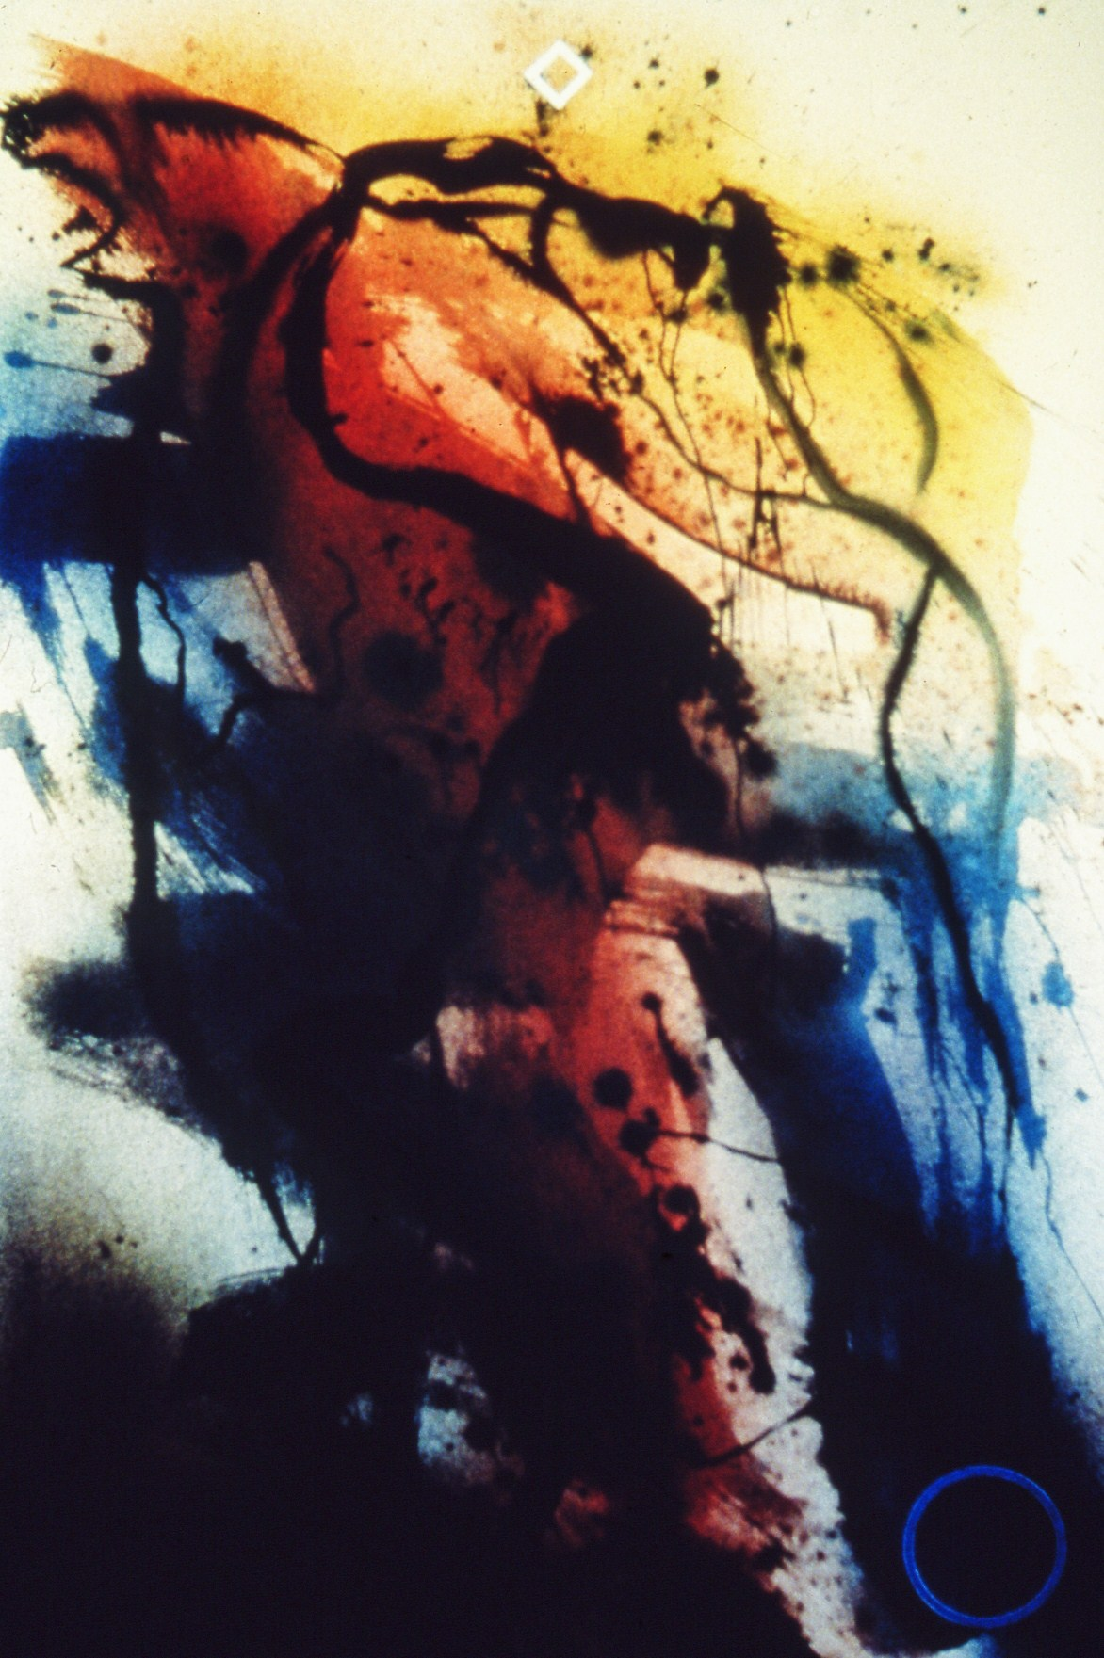
Fred Martin

Slide 3
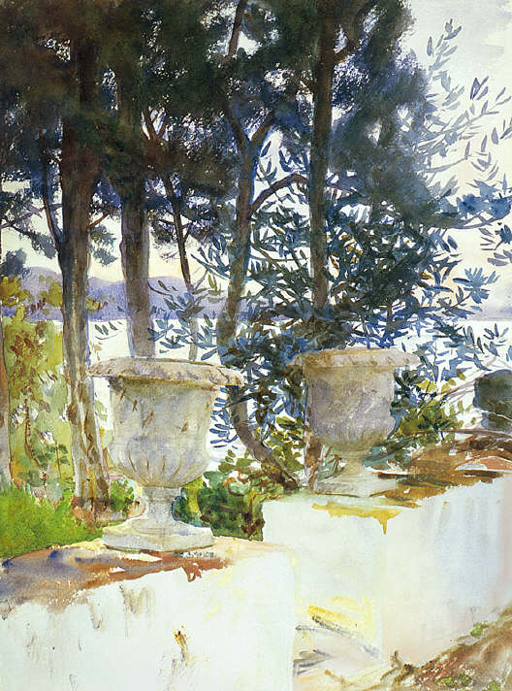
John Singer Sargent, 1900

Slide 4
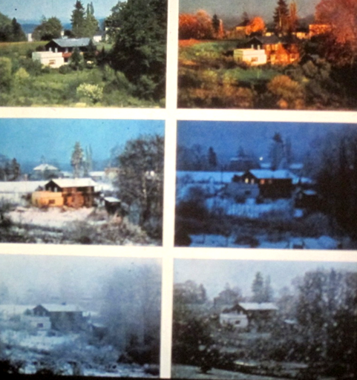
What’s the ‘true color’ of the house?
The ‘real’ color doesn’t exist independently of the light

Slide 5
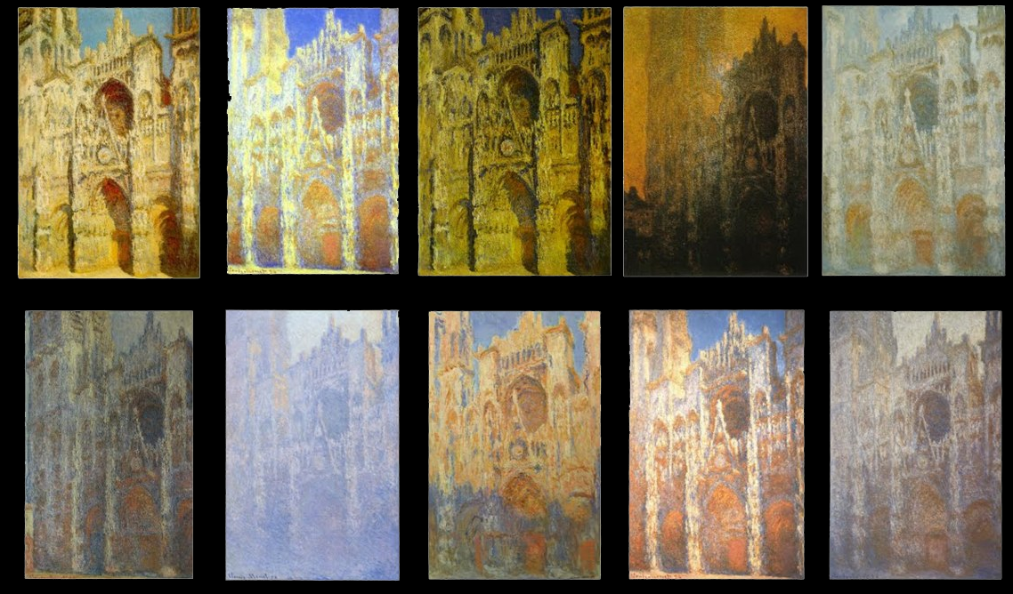
Claude Monet painted the Rouen Cathedral’s ‘white marble’ at different times of day, showing that color doesn’t exist independently of the light

Slide 6
What are the three qualities of color in addition to ‘hue’?
‘hue’ = what most people think of when we say ‘color’ – the apple is ‘red,’
the lemon is ‘yellow,’
the ocean is ‘blue’

Slide 7
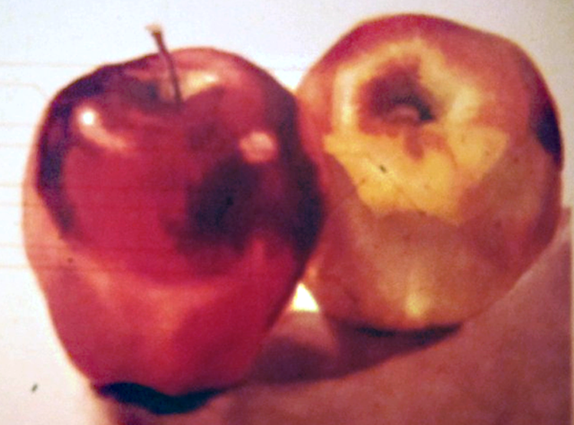
Intensity = how bright or how dull - e.g., toned down with a brown or diluted with water
Value = the contrast of light and dark tones –
e.g., what would the object look like in a black-and-white photo?
Temperature = warm and cool varieties of each hue –
e.g., a warm orangey red and a cool purplish red

Slide 8
‘Value’

Slide 9
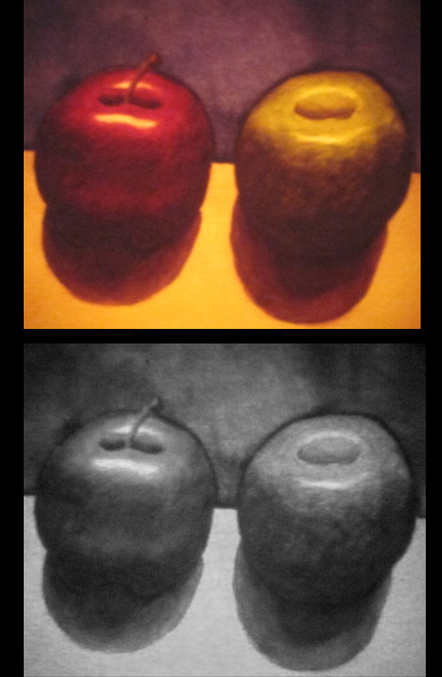
“value” =
the black-and-white version of the color.
Dramatic feeling comes from the contrast of light and dark.

Slide 10
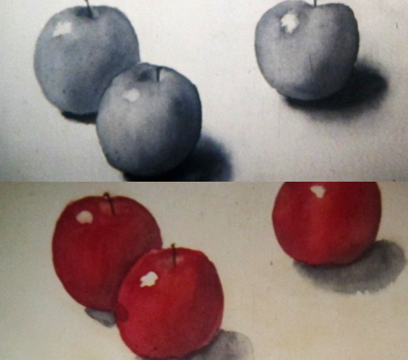
“value” =
the black-and-white version of the color.

Slide 11
“value” =
the black-and-white version of the color.

Slide 12
‘Intensity’

Slide 13
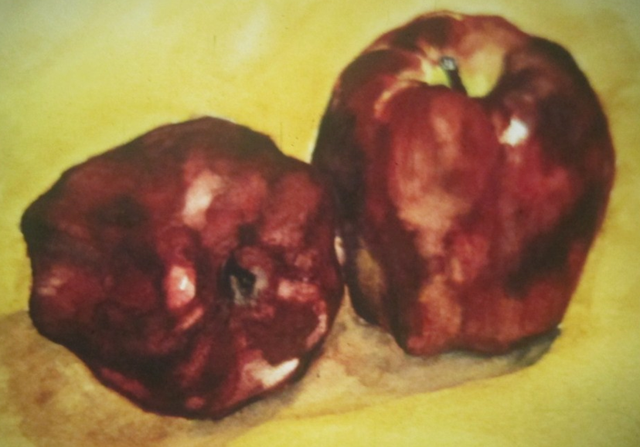
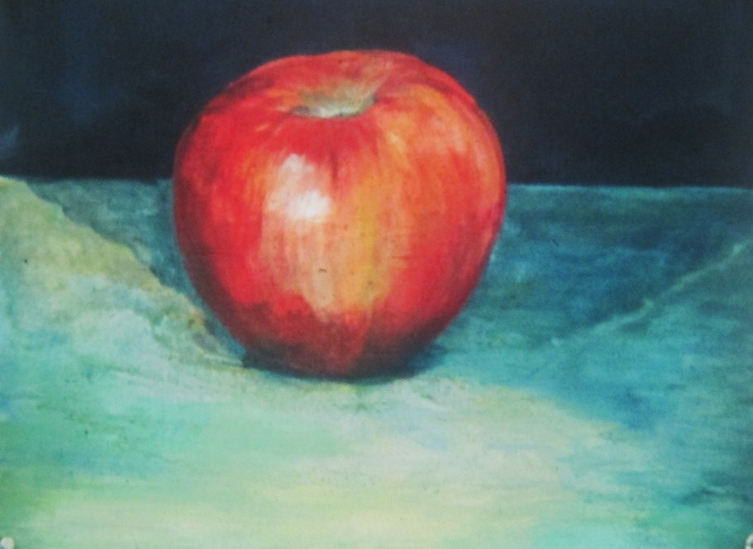
Intensity = how bright or how dull -
e.g., toned down with a brown or gray or diluted with water
These apples have great contrast of value but all the reds are kind of ‘dull’
This apple has touches of ‘bright’ red which enhance the drama

Slide 14
‘Temperature’

Slide 15
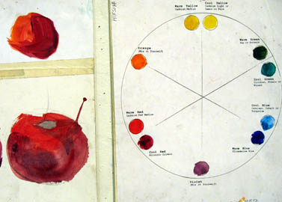
Temperature
= warm and cool varieties of each hue –
e.g., a warm orangey red and
a cool purplish red

Slide 16
the ‘chromatic scale’

Slide 17
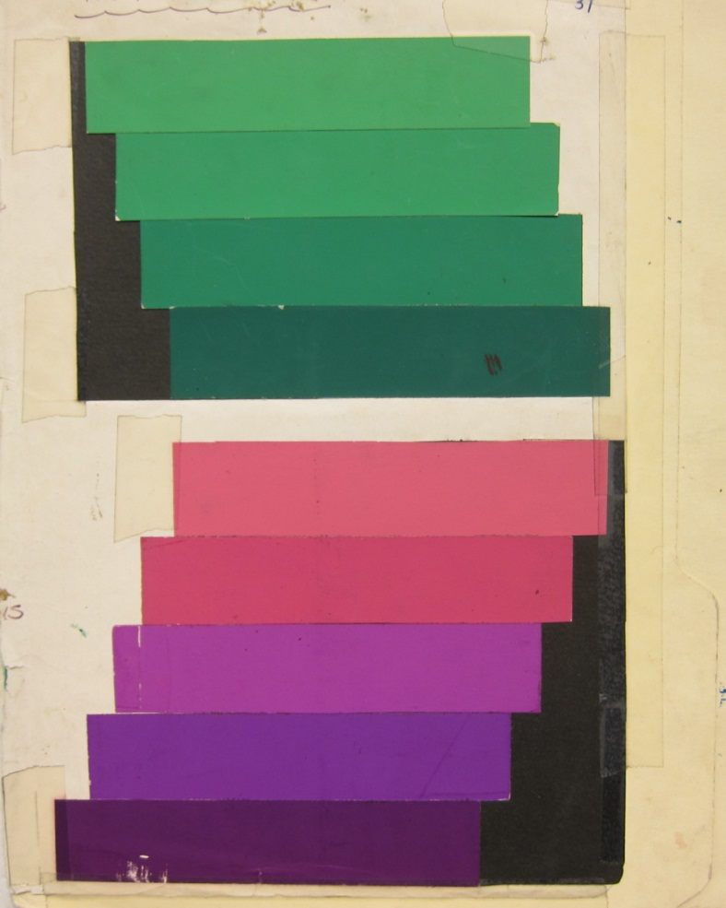
The chromatic scale uses measured ‘steps’ changing a hue in 3 ways:
Value: Light to dark
Intensity: Bright to dull
Temperature: Warm to cool

Slide 18
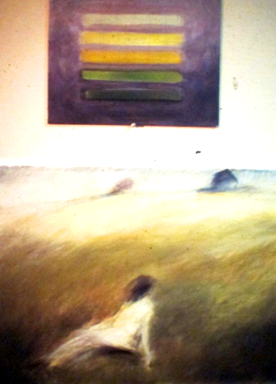
Chromatic scale

Slide 19
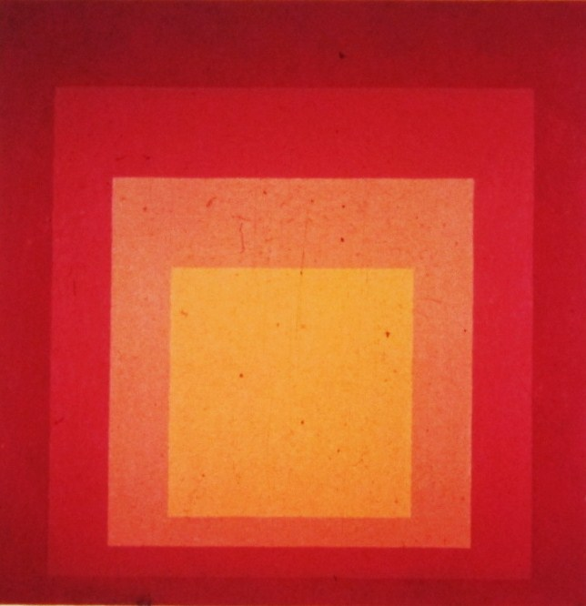
Joseph Albers 1930

Slide 20
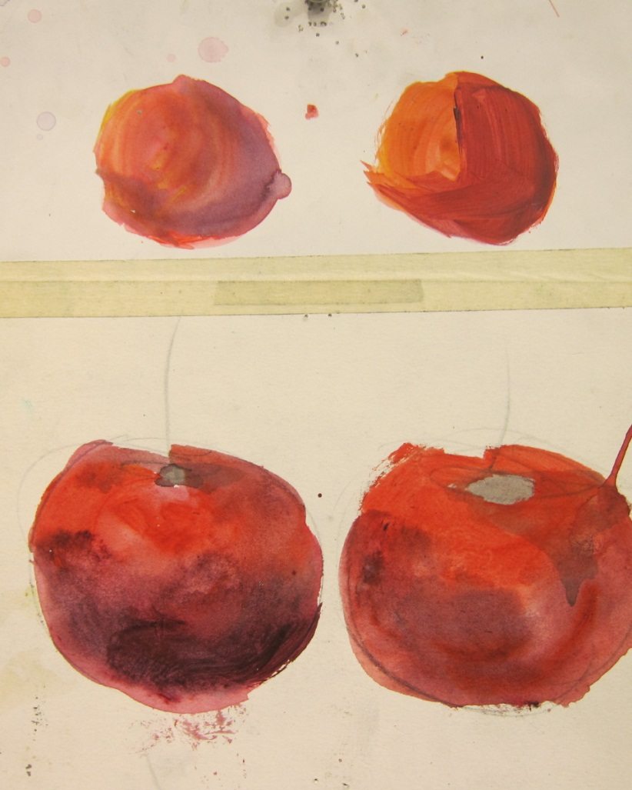
When we paint a red apple, we use the ‘chromatic scale to enhance the illusion of “light”
Value: Light to dark
Intensity: Bright to dull
Temperature: Warm to cool

Slide 21
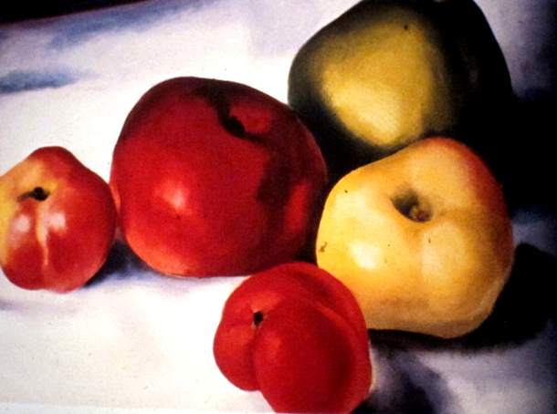
Georgia O’Keefe

Slide 22
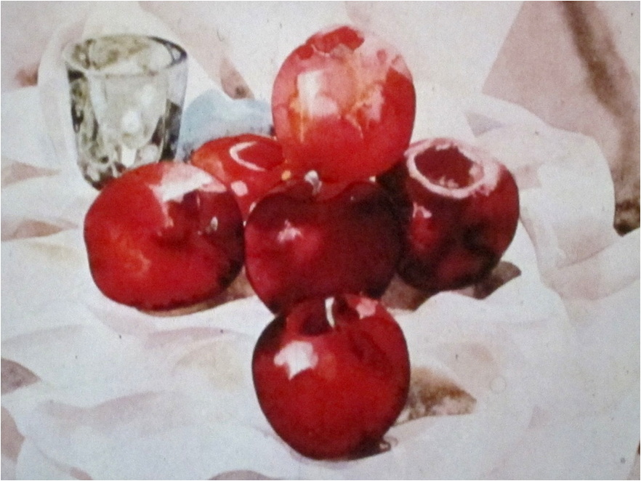
Charles Demuth

Slide 23
painting color in layers

Slide 24
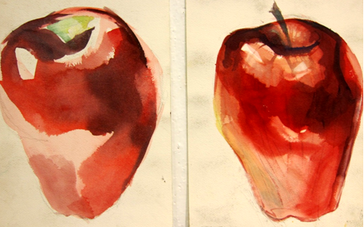
Let each layer dry before going to the next
step 1 step 2

Slide 25
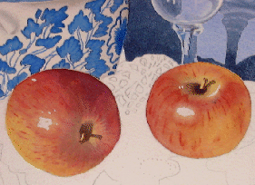
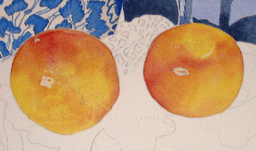
Let each layer dry before going to the next
step 1 step 2

Slide 26
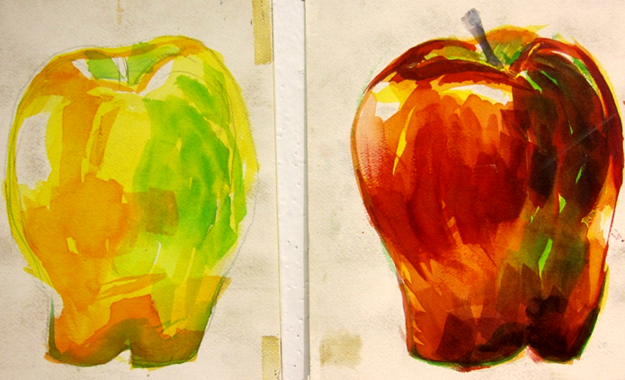
Or try a yellow/green under painting and then red on top
step 1 step 2

Slide 27
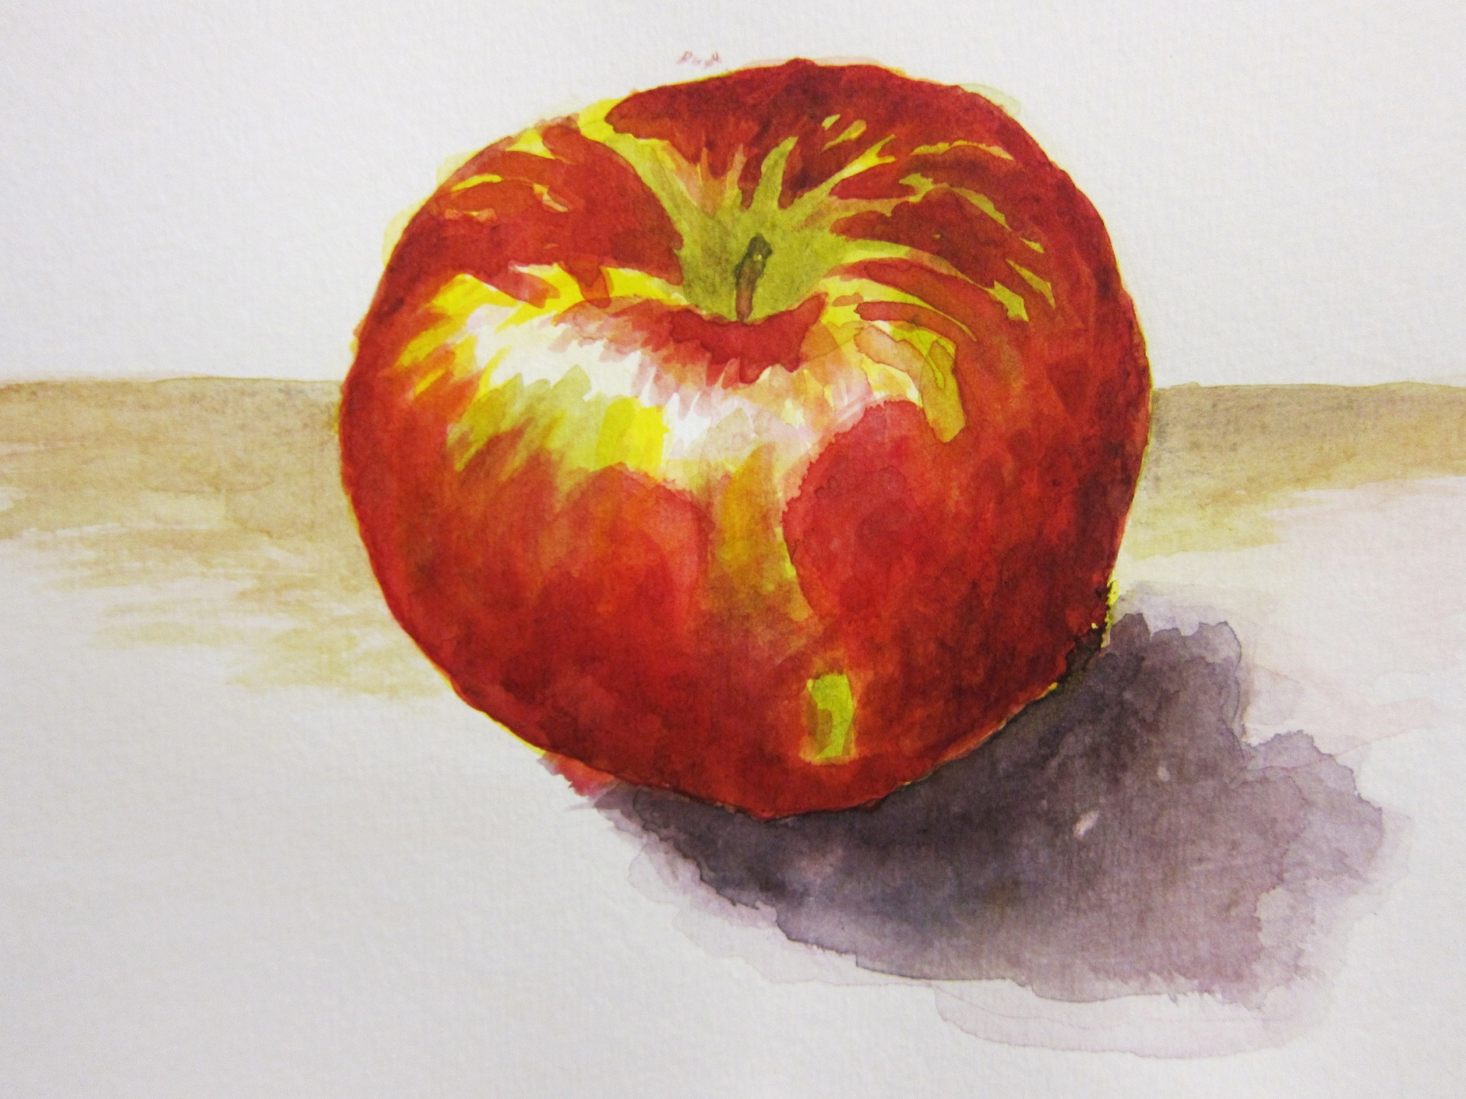
Student Kelly Paik

Slide 29
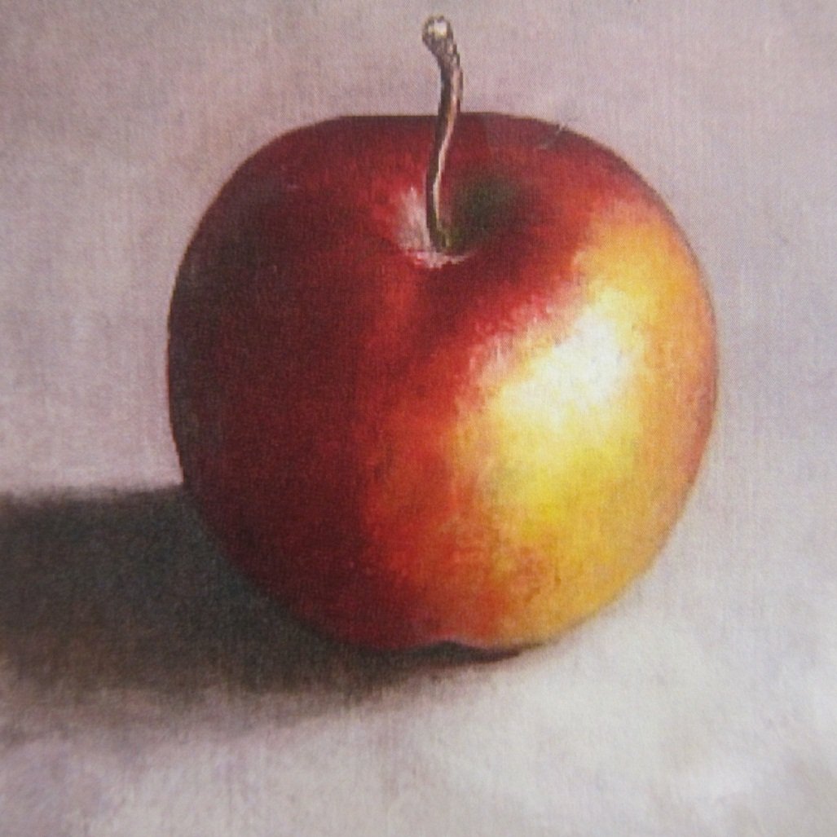

Slide 30
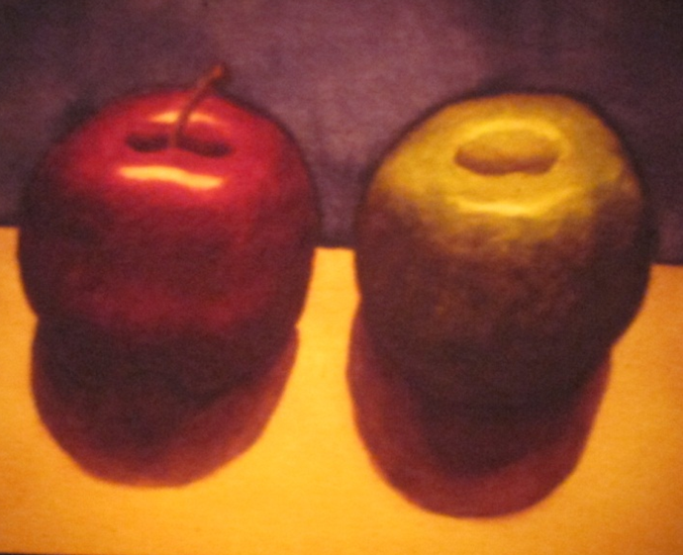

Slide 31
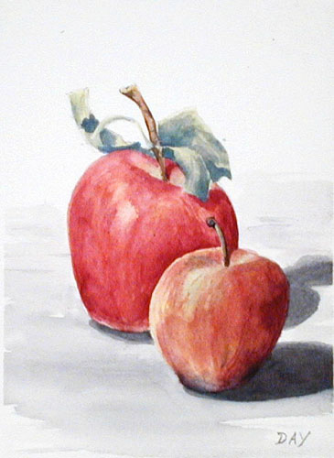

Slide 32
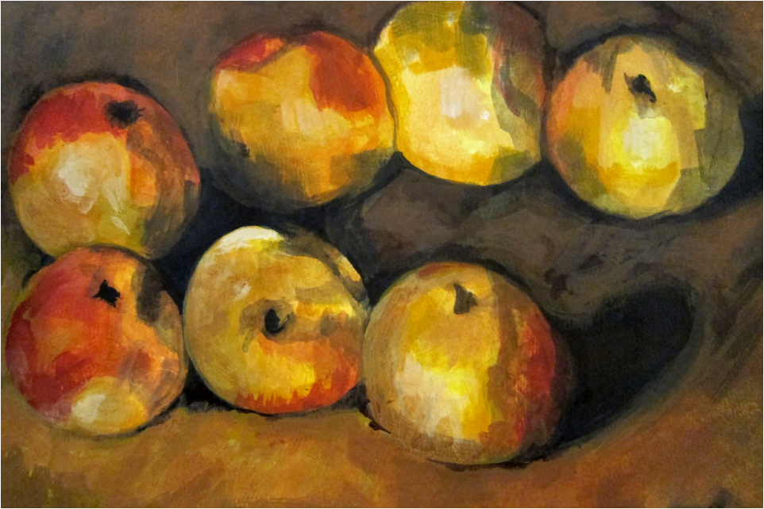
Student study of Cezanne

Slide 33
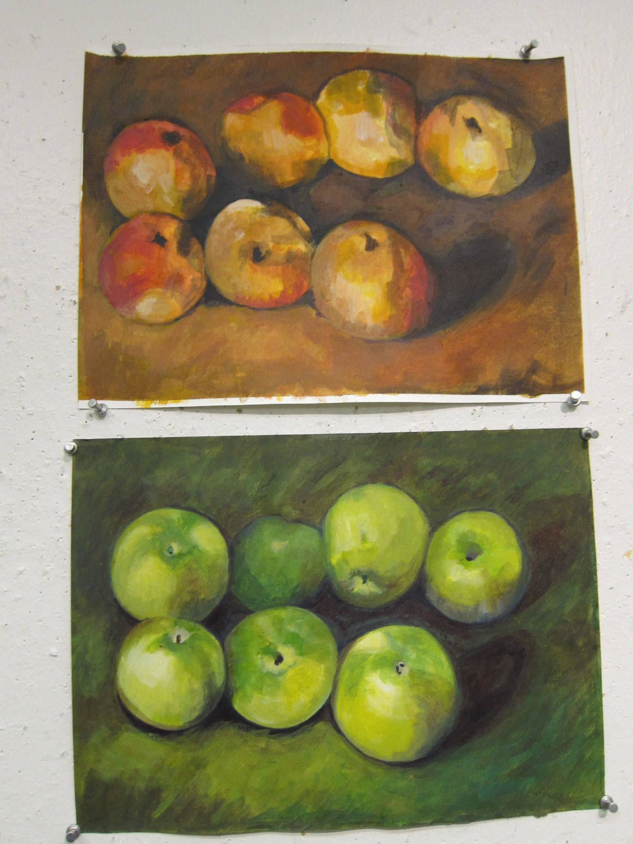

Slide 34
Start in class and finish as homework: paint a still life (doesn’t have to be apples)

Slide 35
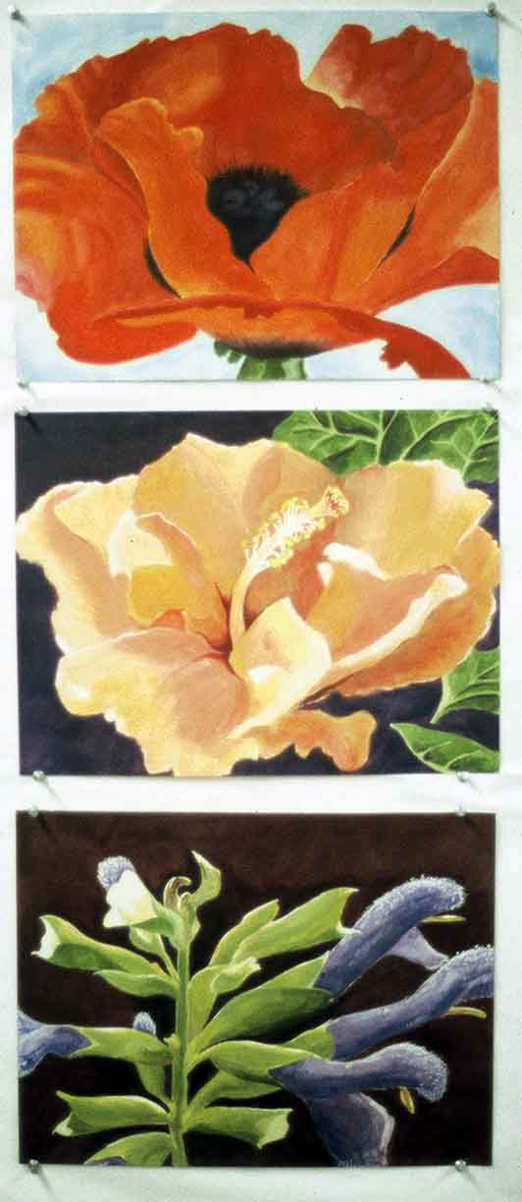

Slide 36
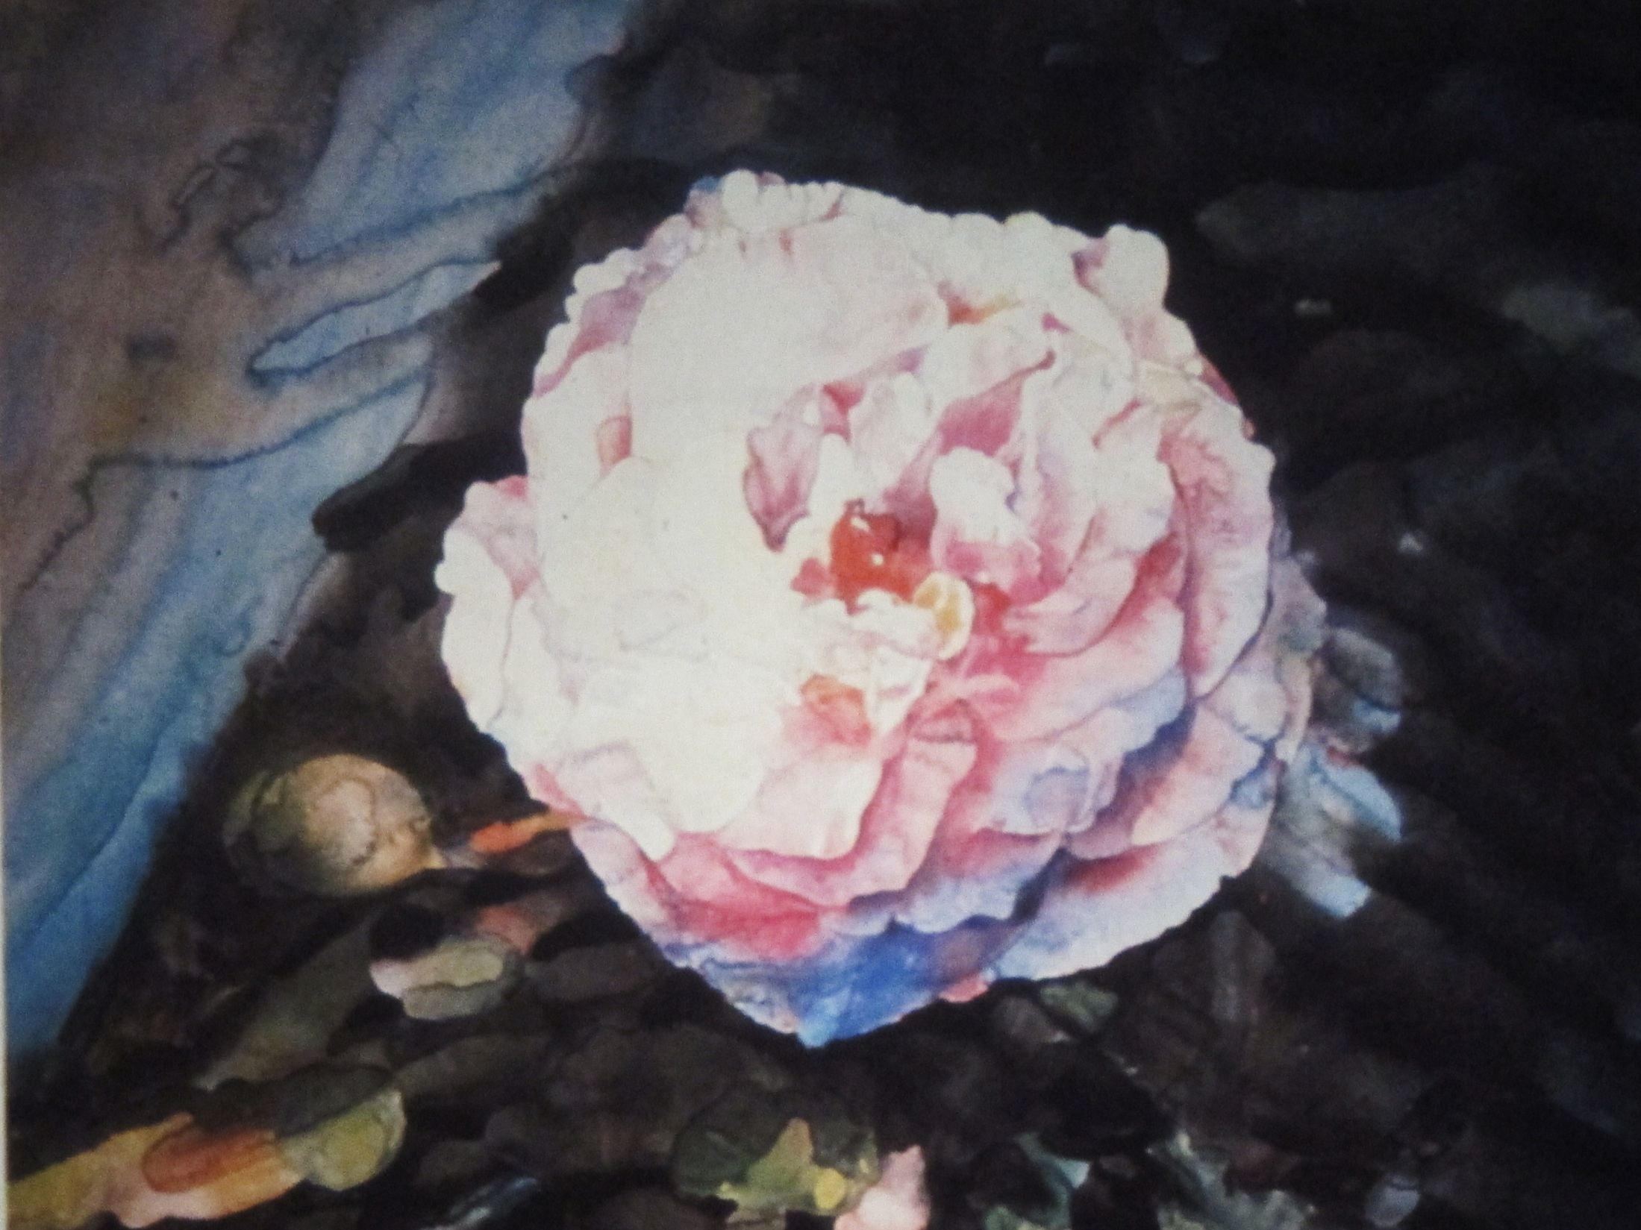

Slide 37
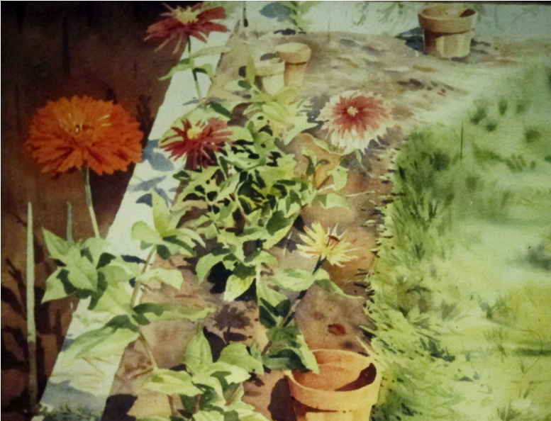

Slide 38
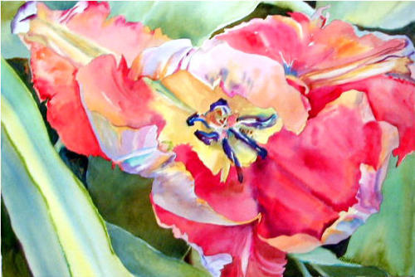
Notes:
Georgia O’Keefe

Slide 39
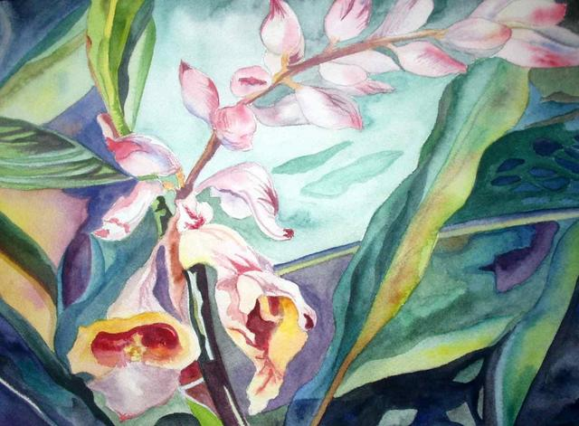

Slide 40
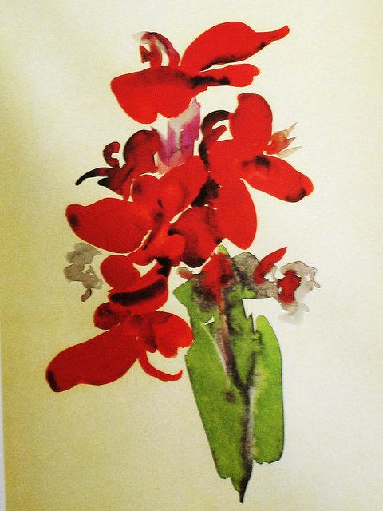
Notes:
Georgia O’Keefe

Slide 41
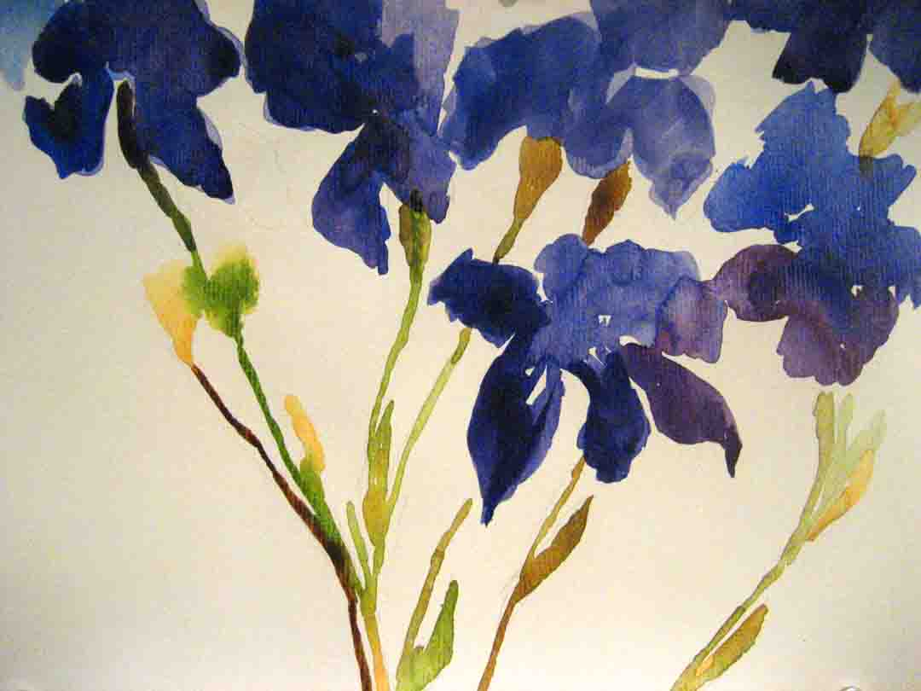

Slide 42
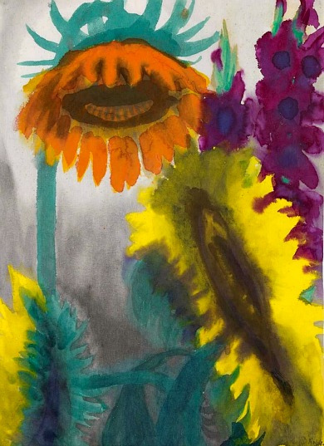
Notes:
Emile Nolde

Slide 43
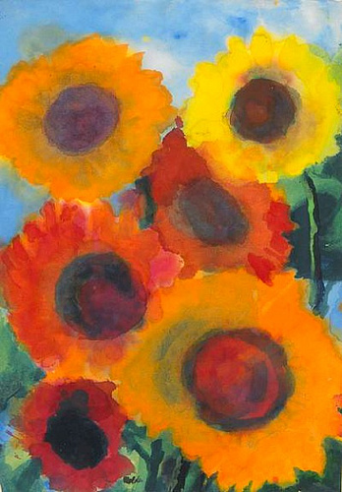
Notes:
Emile Nolde

Slide 44
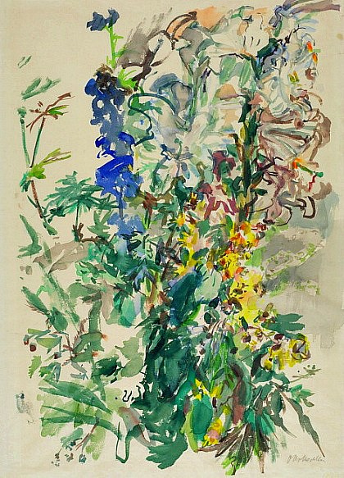
Notes:
Oskar Kokoschka Various Flowers 1939-40

Slide 45
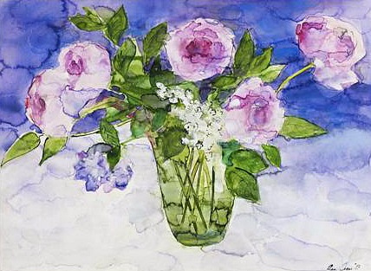
Notes:
Ann Oram (recent)

Slide 46
Have fun with the arrangement of shapes (composition)

Slide 47
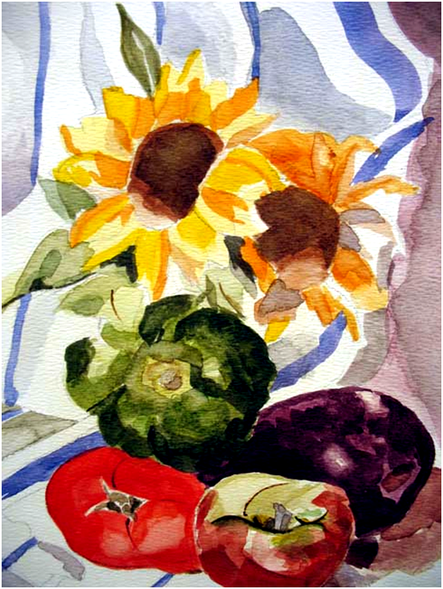

Slide 48
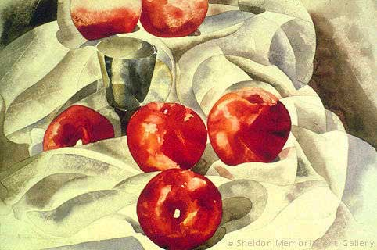

Slide 49
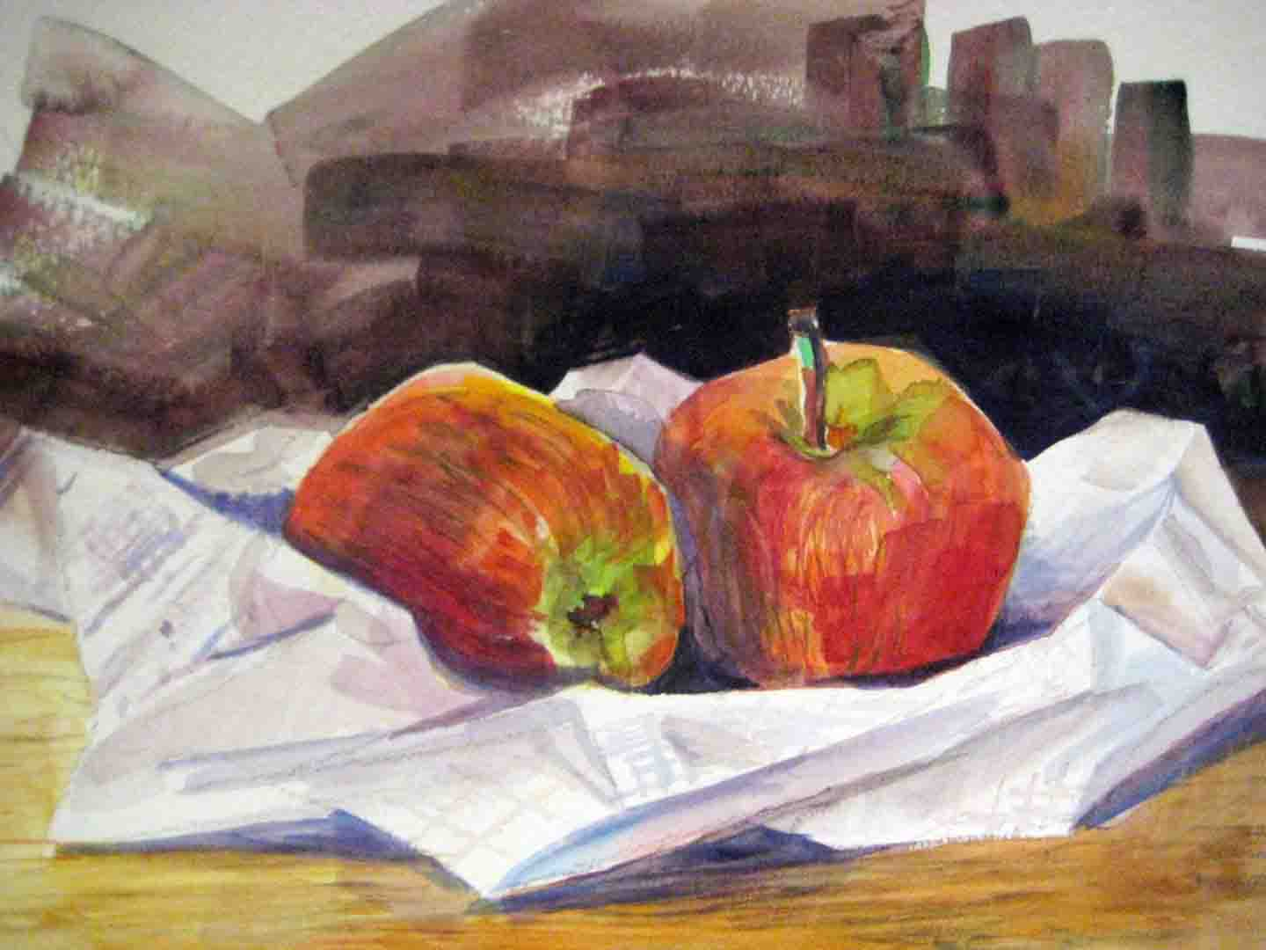

Slide 50
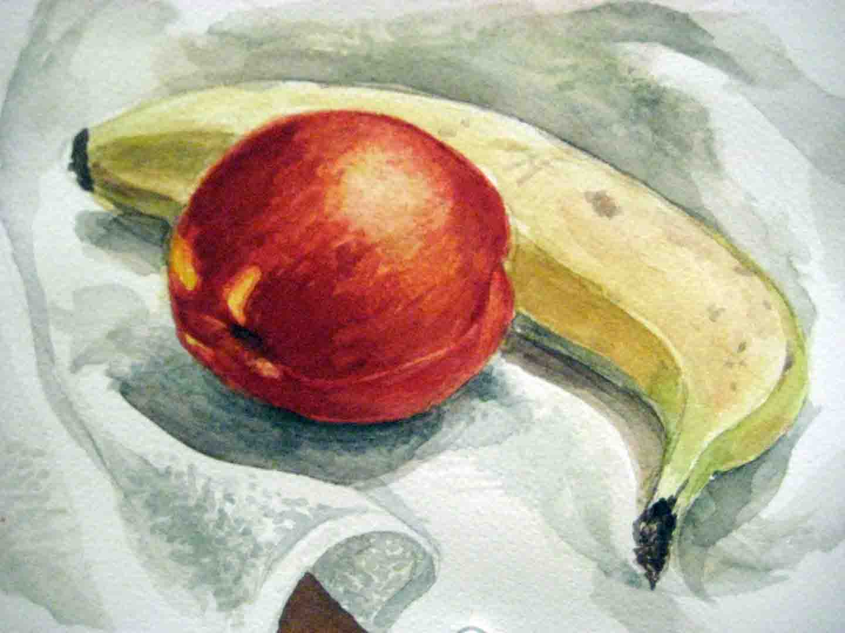

Slide 51
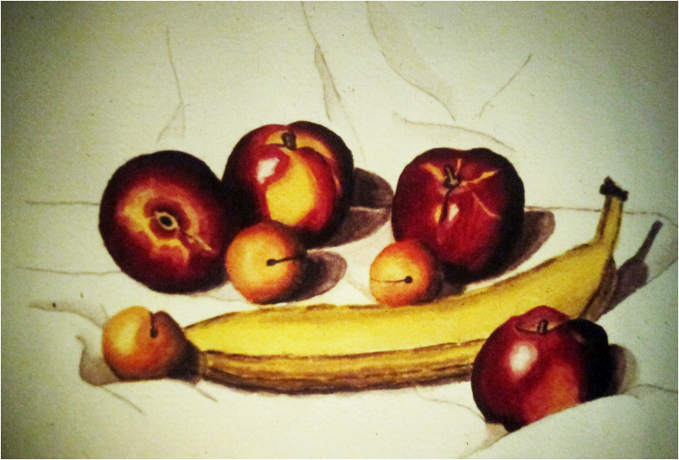

Slide 52
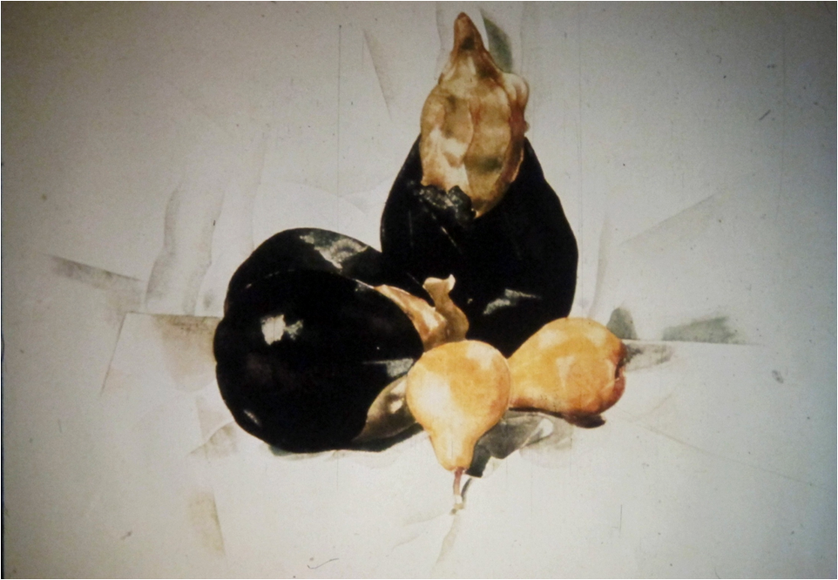

Slide 53
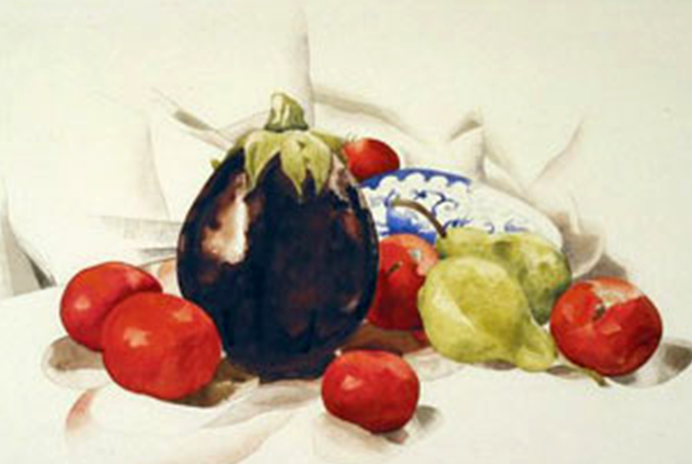

Slide 54
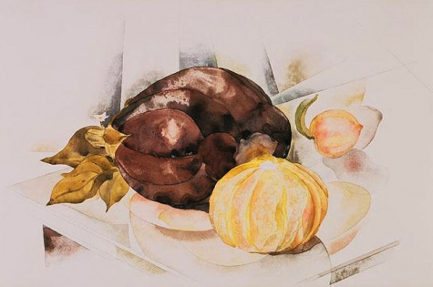

Slide 55
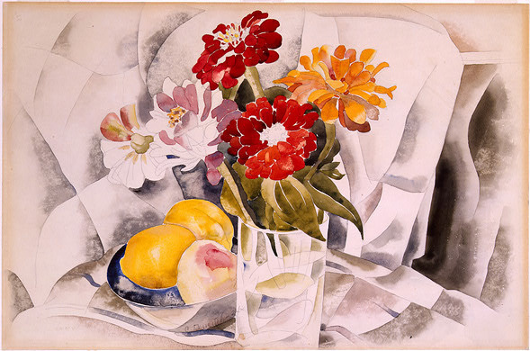
Notes:
Charles Demuth

Slide 56
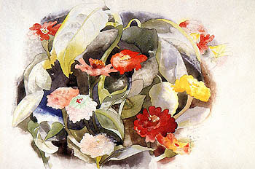

Slide 57
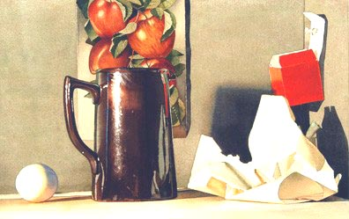

Slide 58
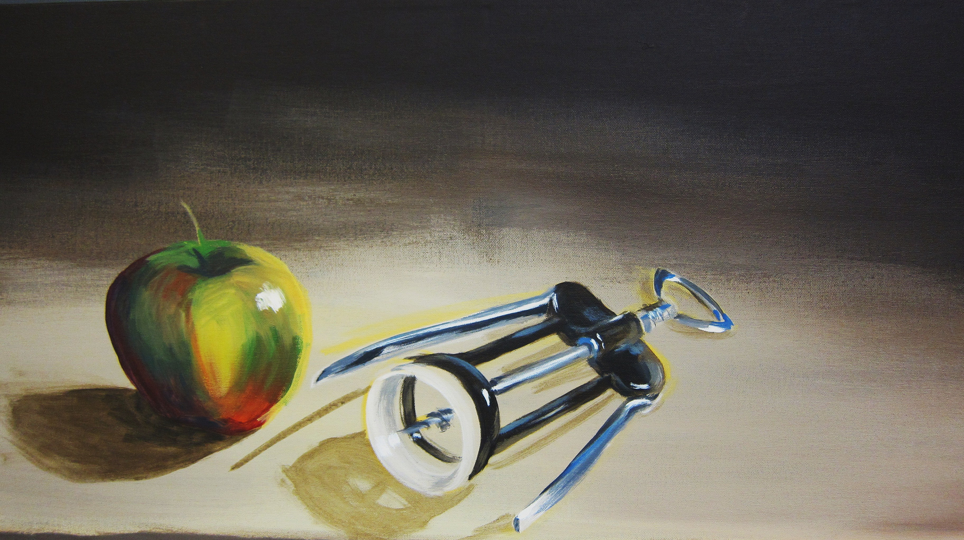

Slide 59
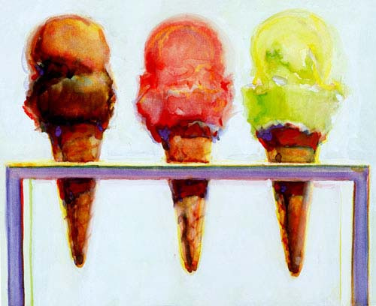

Slide 60
First do a thumbnail sketch on a separate piece of paper
No detail – block in the light & shadow

